Slide 1
Technology in America
Professor Meyer

Slide 2
Quiz 2
Which of the following are NOT “taboo” conversation topics?
  TV Shows
  Politics
  Religion
  Body Weight
Why is the American government separated into 3 branches? (hint: separation of power)
Extra Credit: Describe one of the science project from the article STEM: Making a Difference.
Notes:
Inside View: Conversation 1

Slide 3
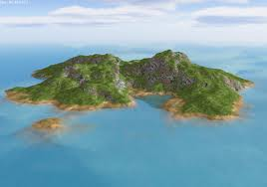
Survivor
You are stranded on an island, but for some magical reason, you can choose any 3 things to help you survive.
  Share with your team your best survival skill.
  As a team, choose 3 things to have on the island to help you survive.
  Share with the class, the 3 items your team chose and why those items make you more capable of surviving.
Only use English!

Slide 4
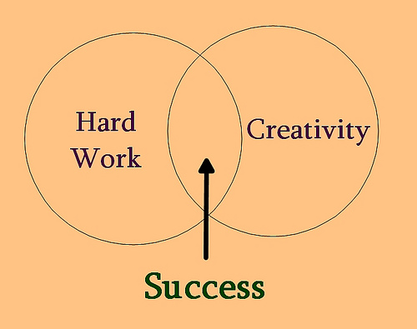
Hard Work
Hard workers are admired
Motivated by achievement
Action
Works efficiently and
doesn’t waste time
Notes:
Family backgrounds, educational attainments, and other characteristics are considered less important in identifying people than the jobs they hold.
A hard worker is one who “gets right to work” on a task, works efficiently, and completes the task in a timely way that meets reasonably high standards of quality.
“He’s a hard worker,” one American might say in praise of another. Or, “She gets the job done.” These expressions convey the typical U.S. American’s admiration for a person who approaches a task conscientiously and persis- tently, seeing it through to a successful conclusion. More than that, these expressions convey an admiration for achievers, people whose lives center on accomplishing some physical, measurable task. Social psychologists use the term achievement motivation to describe people who place a high value on getting things done.

Slide 5
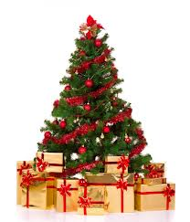
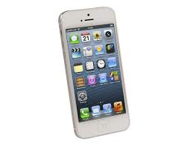
Materialism
Luxuries now considered necessity
Notes:
Items that they once considered luxuries, such as personal electronic devices, large-screen television sets, cellular telephones, and electric garage-door openers are now considered necessities.

Slide 6
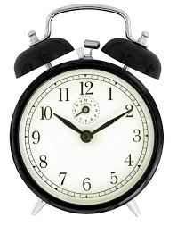
Time
“Time is a money.”
Punctuality: doing something at the
agreed upon time
  Be considerate of other people’s time
Non-American time orientation
  Orientation: The direction of someone's interest or attitude
  Americans are sometimes seen as machine-like
Example: the fast food industry
  KFC, McDonald’s, Pizza Hut, etc.
Notes:
Americans are sometimes seen by international visitors as automatons, inhuman creatures who are so tied to their clocks, their schedules, and their daily planners that they cannot participate in or enjoy the human interactions that are necessary to a fulfill- ing life. “They are like little machines running around,” one international visitor said.
n this context the “fast-food industry” is an excellent example of an American cultural product. McDonald’s, KFC, Pizza Hut, and other fast-food establishments prosper in a country where many people want to minimize the amount of time spent preparing and eating meals. The mil- lions of Americans who take their meals at fast-food restaurants cannot be interested in lingering over their food while talking with friends, in the way millions of Europeans do.

Slide 7
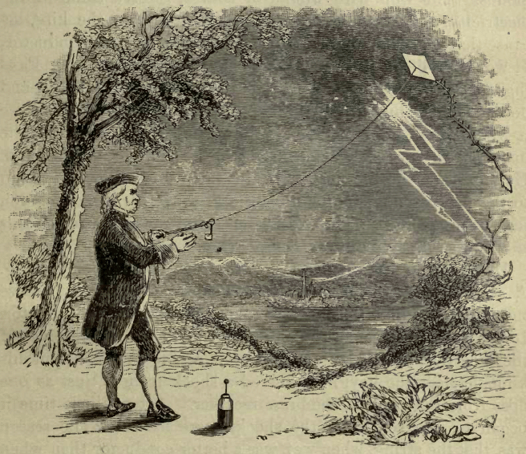
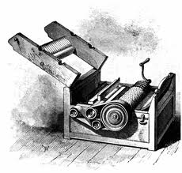
Early American Technology
Ben Franklin: 1706-1790
  Electricity; invented the lightning rod
Eli Whitney: 1765-1825
  Invented the cotton gin
  Revolutionized cotton
  industry

Slide 8
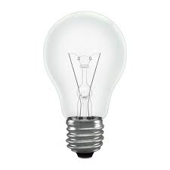
Industrial Revolution: 1870-1914
Nikola Tesla: 1856-1943
  Alternating current (AC) motor, light bulbs, x-rays, Tesla coil, radio, remote control, robotic, lasers, wireless communications
Thomas Edison: 1847-1931
  Stole inventions from Tesla
  Menlo Park Labs
Henry Ford: 1863-1947
  Assembly line enabled mass production

Slide 9
Computer Revolution
Internet: 1950s-current
  Originated in American universities
  Internet=knowledge; knowledge=power
Personal computing: 1970s
  Made popular due to innovation from entrepreneurs like Bill Gates and Steve Jobs
Google: 1990s
  Indexing the internet
Apple: 2000-current
  iPhone and iPad apps
Notes:
entrepreneur |ˌäntrəprəˈno͝or, -ˈnər|nouna person who organizes and operates a business or businesses, taking on greater than normal financial risks in order to do so.

Slide 10
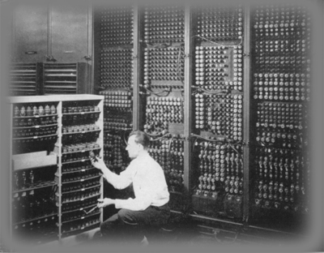

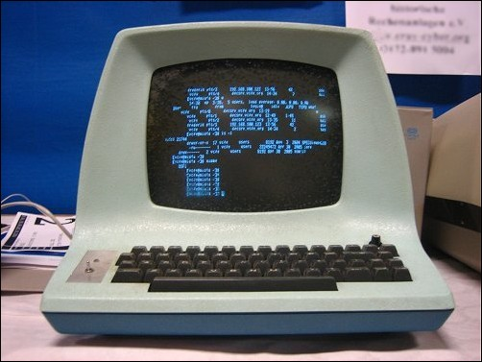
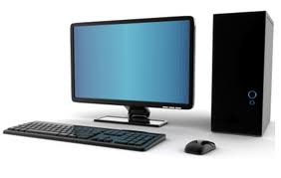
What do you think was the greatest invention?
Why?

Slide 11
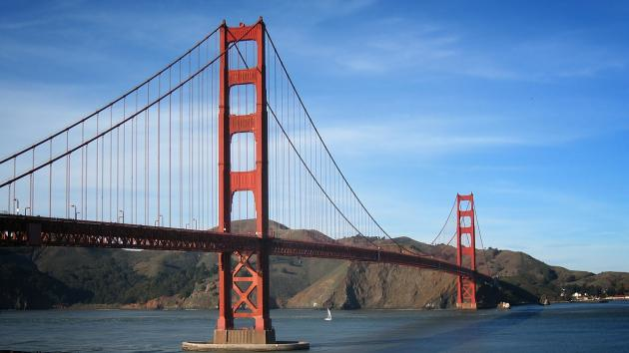
Future of Technology
Start up culture
  San Francisco: start up hub
  Reflect American individualism
What’s next?
  Smart Things
  Biotechnology
Notes:
start-up |ˈstɑr ˌdəp|(also startup |ˈstärtˌəp|)nounthe action or process of setting something in motion: the start-up of marketing in Europe | [ as modifier ] : start-up costs.• a newly established business: problems facing start-ups and small firms in rural areas.
biotechnology |ˌbīōtekˈnäləjē|nounthe exploitation of biological processes for industrial and other purposes, esp. the genetic manipulation of microorganisms for the production of antibiotics, hormones, etc.

Slide 12


Slide 13
Speaking Activity
If you could start a startup, what would you do?
  Think of a great business idea for your startup.
  Share it with your classmates.
  Try to convince people that your idea will be the best and most profitable business.
  Gather “investors” and stay together in a group.
  Try to form the biggest group.

